Slide 1

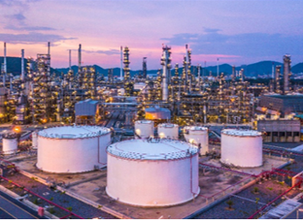
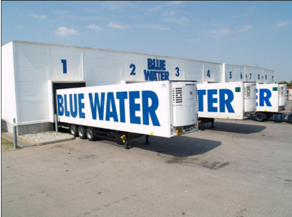
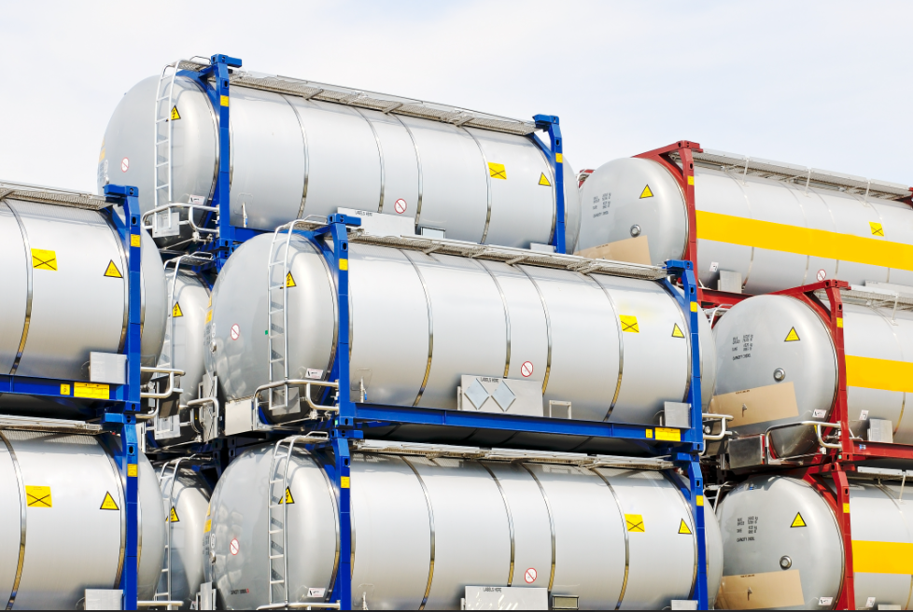
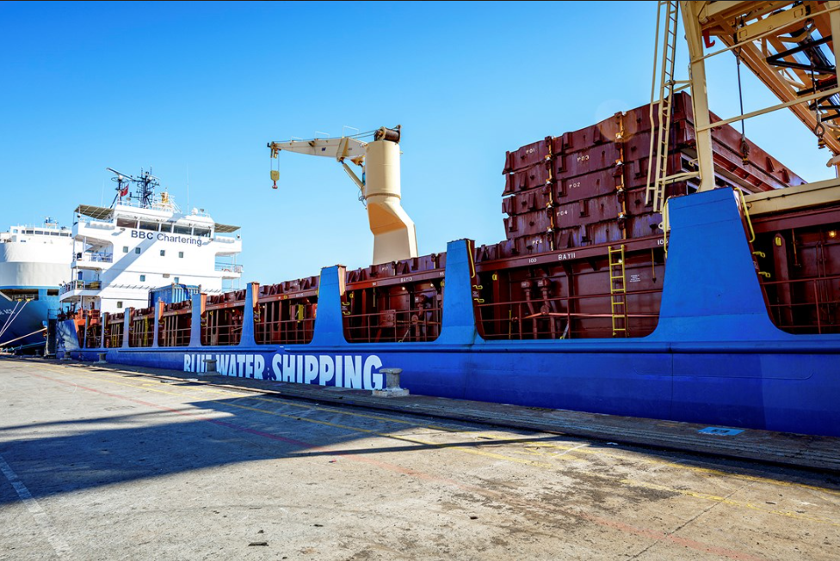
EPCA Vienna 2023
Global Chemical Logistics and Supply Chain Solutions

Slide 2



Facts about Blue Water
Global Transport, Supply Chain Services, and Freight Forwarding Company
Founded in DK
1972
Turnover 2022
1.5bn USD
Offices
75+
Employees
2,500+

Slide 3
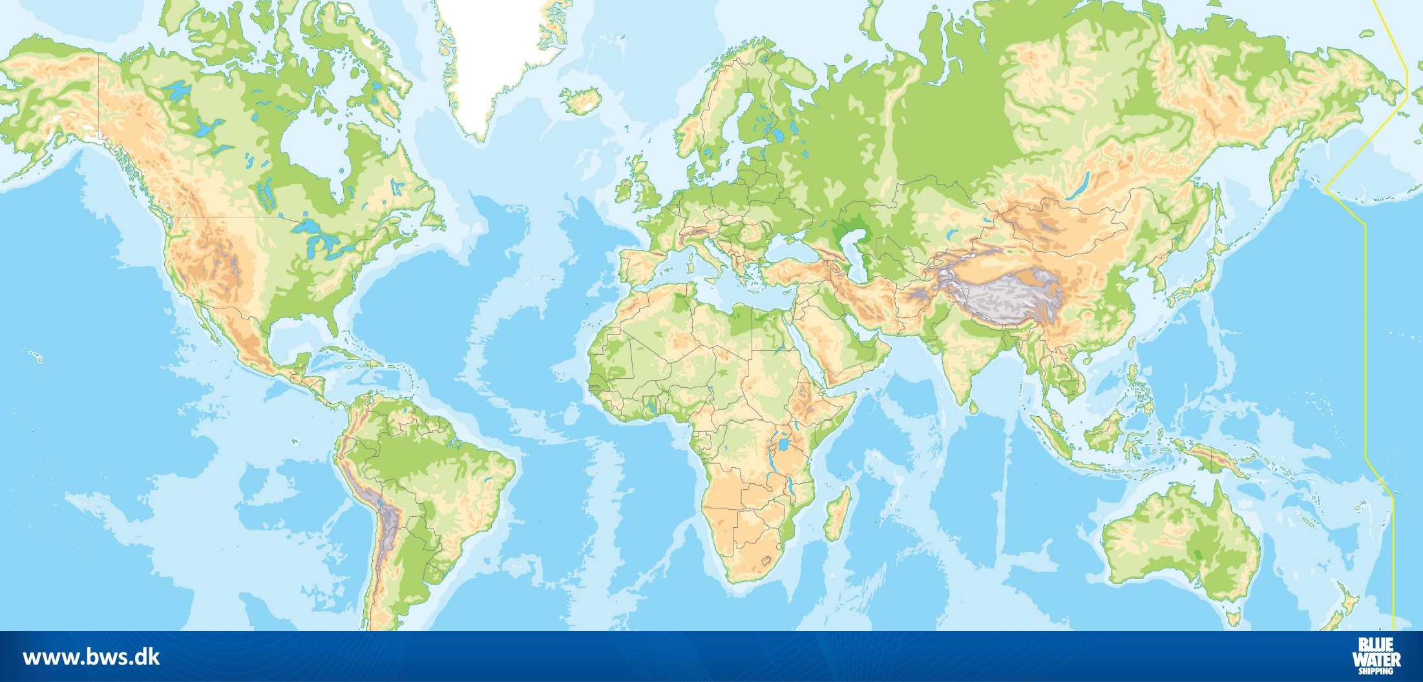













Our Specialists Worldwide
Billund
Esbjerg
Dubai
Houston
Singapore
BWS Charter
BWS Technical Engineering Team
Rio de Janeiro
BWS offices
Agents

Slide 4
Together We Create Solutions
Our company is based on in-house competences and expertise
Freight Forwarders
Freight Forwarders
Freight Forwarders
Freight Forwarders
Shipping
Experts
Shipping
Experts
Shipping
Experts
Shipping
Experts
Shipbrokers
Shipbrokers
Shipbrokers
Shipbrokers
Customs
Brokers
Customs
Brokers
Customs
Brokers
Customs
Brokers
Quality
Inspectors
Quality
Inspectors
Quality
Inspectors
Port
Captains
Port
Captains
Stevedore
Foremen
Stevedore
Foremen
Stevedore
Foremen
Naval
Engineers
Naval
Engineers
Naval
Engineers
Naval
Engineers
IT
Developers
IT
Developers
IT
Developers
HSSEQ
Specialists
HSSEQ
Specialists
Legal
Advisors
Legal
Advisors
Chartering
Agents
Chartering
Agents
Chartering
Agents
Chartering
Agents

Slide 5
Our Solutions
Road Transport
Sea Freight
Air Freight
Rail Transport
Courier Transport
Reefer Logistics
Marine Logistics
Renewables
Port Service
Oil, Gas & Projects

Slide 6

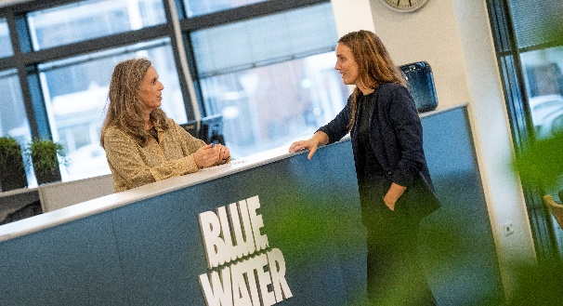
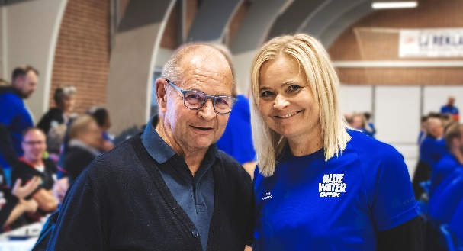
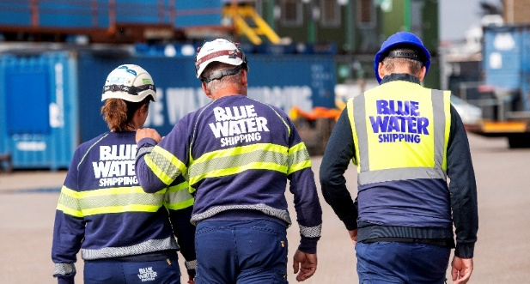
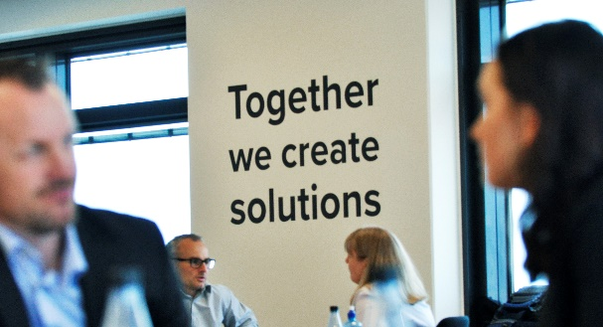

Our values – The Blue Water way
We play as a team
– and we play to win ​
The colour of service is Blue
– we work with passion to serve customers better, every day, everywhere
We keep our promises
– because our business is built on trust
We believe in strong and long-lasting relations
– enabling everyone to run a good business
Our responsibility reaches beyond our business
– we take care of each other, our partners and society
We constantly question status quo
– dedicated to improving our efficiency

Slide 7
Service & Expertise
Aerospace Logistics
Aid & Development
Vessel Chartering
Exhibition Logistics
Gov. & Defence Logistics
North Atlantic
Port Agency
Stevedoring
Technical Engineering
Warehousing
Cargo Insurance
Customs
HSSEQ
IT solutions
Air Charters

Slide 8



BWS Chemical Logistics is a:
  Chemical & Dangerous Goods Solutions Specialist, Freight Forwarder, Multimodal Procurement Partner, Consultancy, HSSEQ Leader, Underpinned With Dedication To Premium Service and Sustainability

Slide 9
Differentiator - Integrated Solutions
Global Procurement
Global Freight Management
Supply Chain Consultancy
Asset Based Solutions
Ocean, Air, Road, ISOtanks, Bulk Shipping, and Customs Brokerage
Procurement Leverage
Global Chartering
Market Knowledge & Expertise
Bespoke shipment processing
Dedicated Chemical Ops
Proactive Visibility & Exception Management
Operations Excellence
  BWS Certifications
KPI and Strategic Analytics
Supply Chain Design
Network modeling / optimization
Operational Supply chain Improvements
Heuristic Modeling
Dedicated Services
Blue Water Vessels (4)
Logistics Management Solutions
Warehousing
Port Services
Compass Enabled
Visibility – Connectivity – Sustainability - Performance
Tracking
Systems

Slide 10
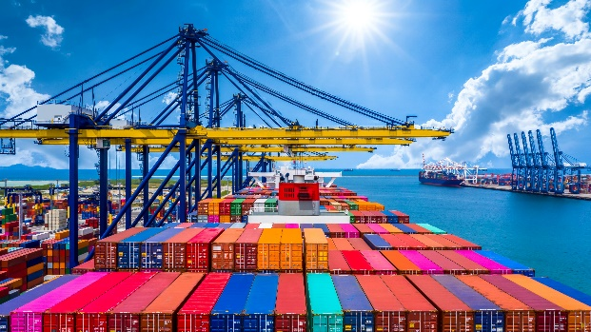
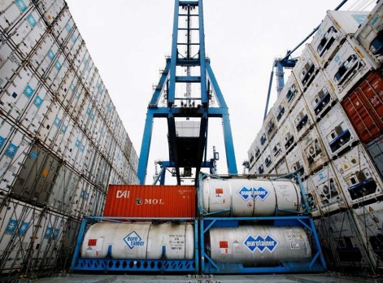
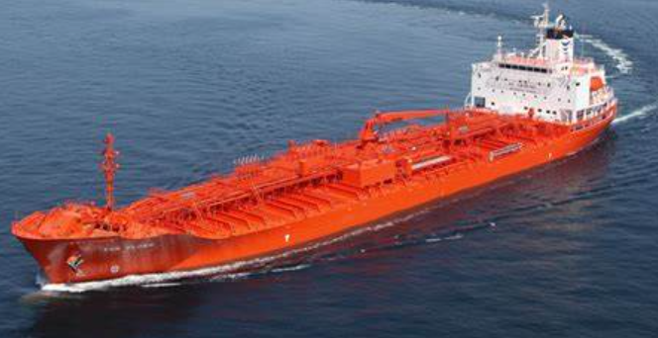
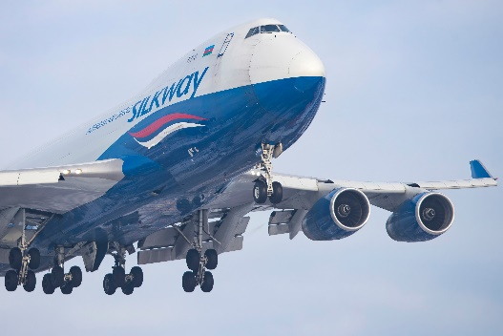
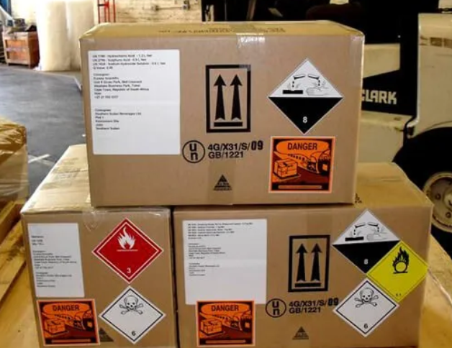
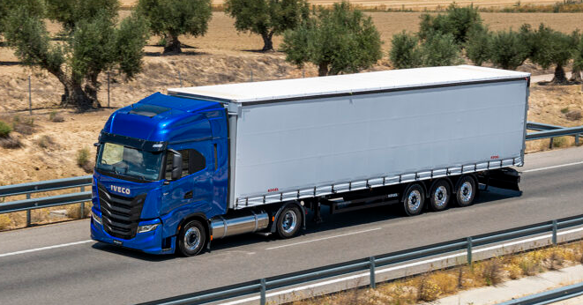
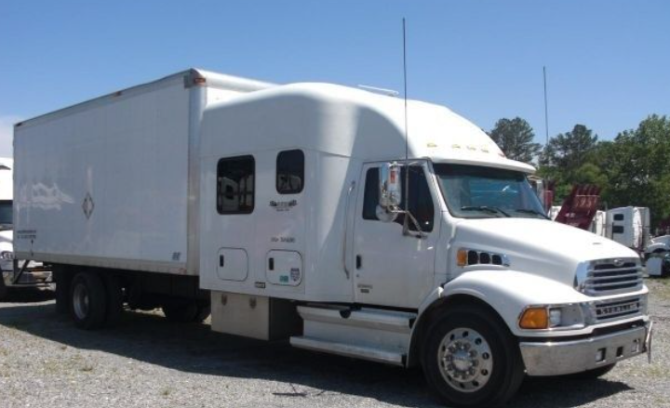
Modes of Chemical Transportation Supported :
Full Containers
ISOTANKS
Bulk Tankers/Charters
Air Charter
Transactional Air
Truckload / Hot Shot

Slide 11

















Chemicals Industry – Differentiating Certifications and Standards
Existing
Chemical Specific
Future

Slide 12

Tailor-made IT Systems
We develop tailor-made IT systems which can be integrated with client systems. Innovative in-house planners, technicians and programmers ensure the best possible solutions.
Our systems include:
Purchase Order Management
Warehouse Management System
Full door-to-door Track & Trace System
Tailor-made KPIs
Local Customs Monitoring
Project Cost Control
Carbon Calculator

Slide 13
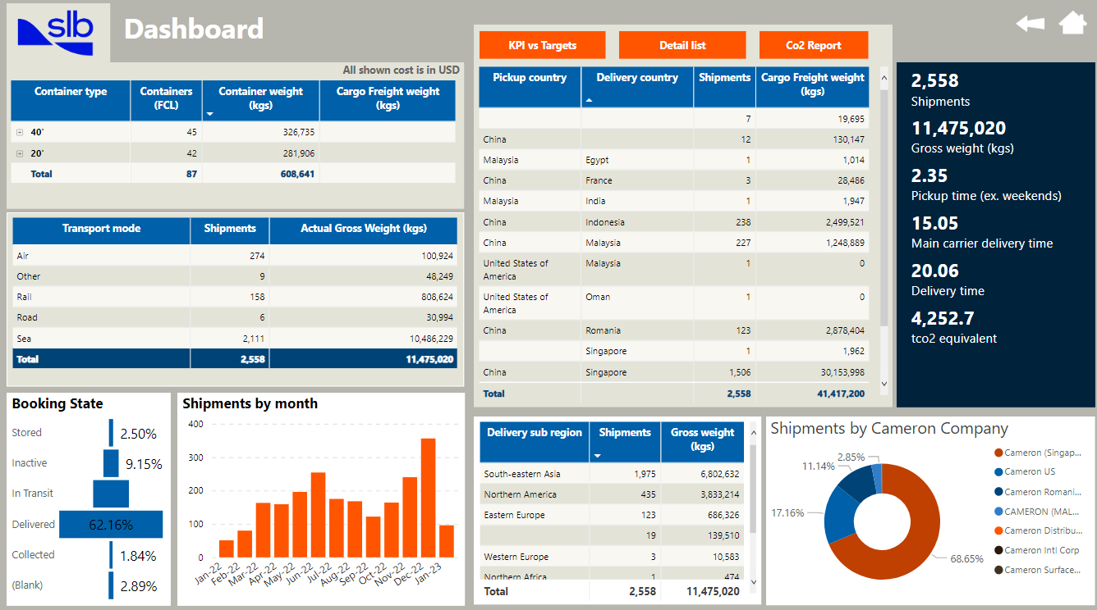
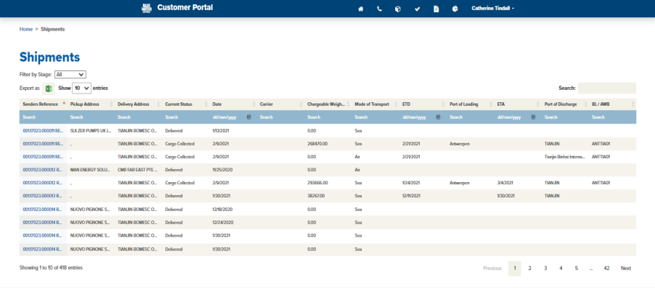

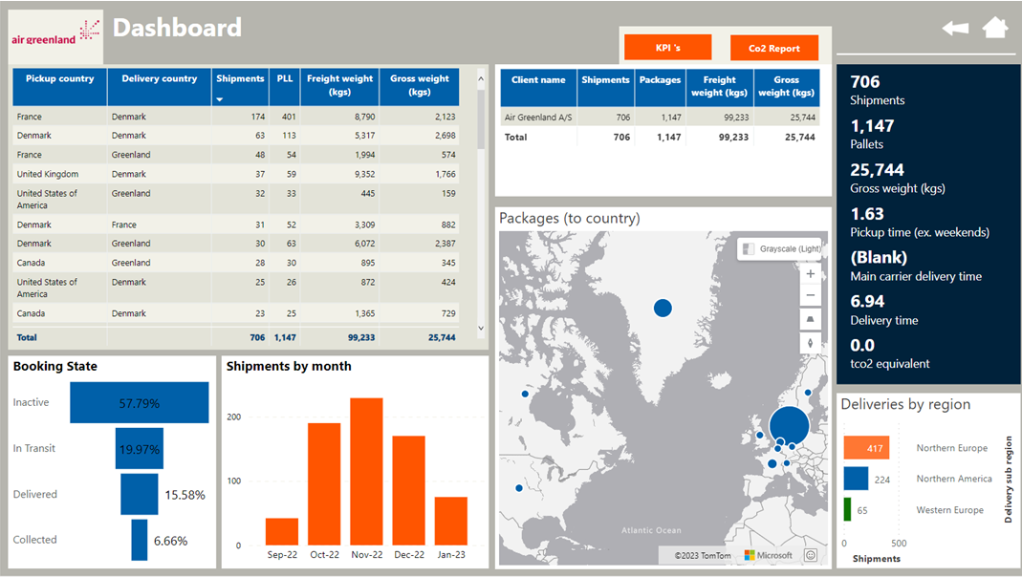
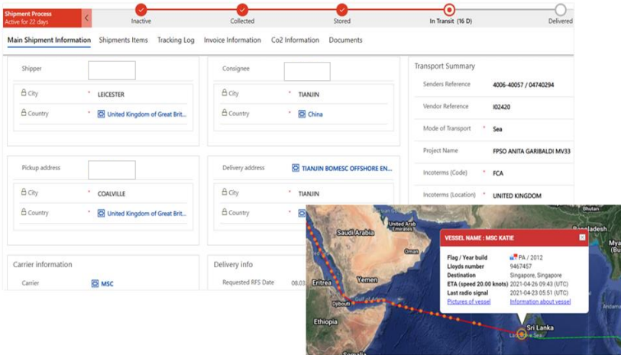
Bespoke Customer Dashboards and Portals
ABC

Slide 14
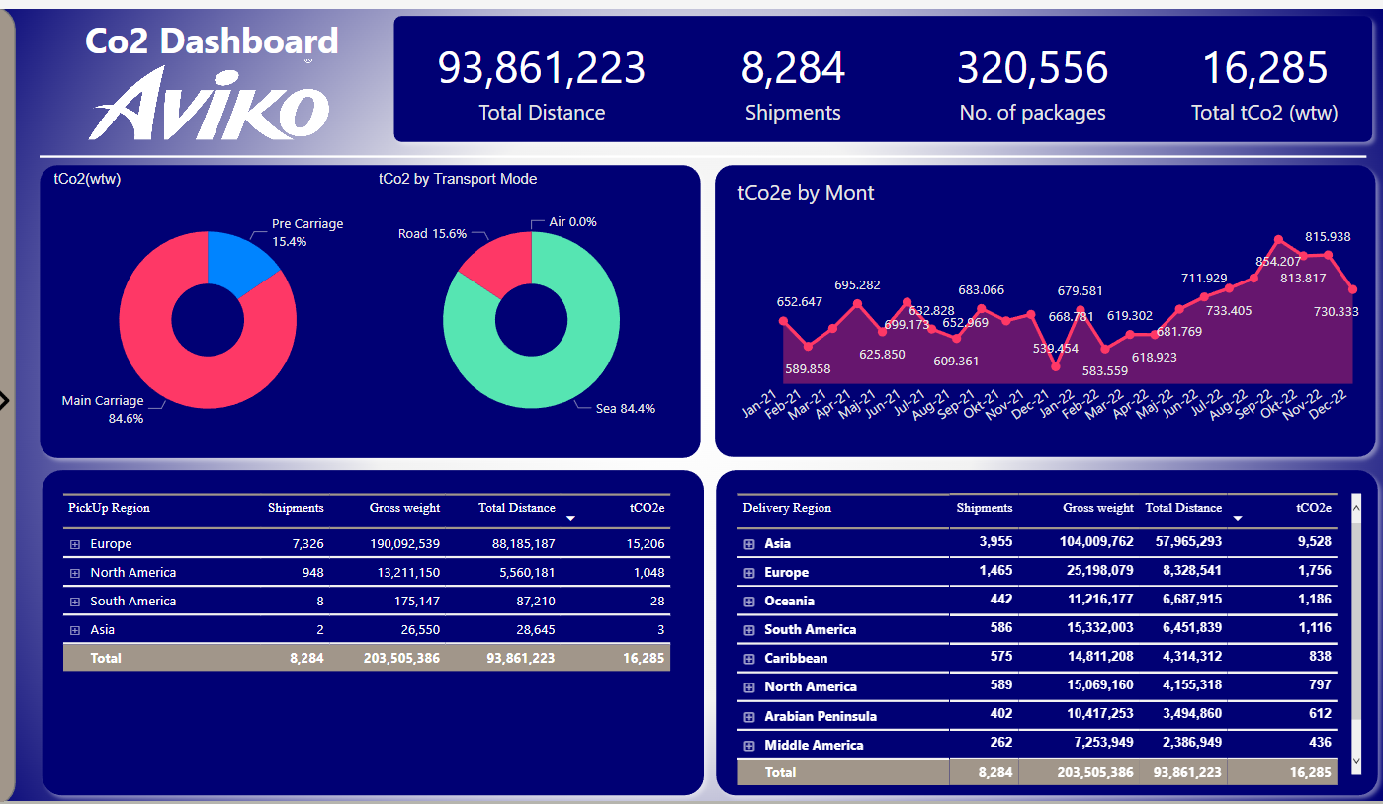
Sample

Slide 15
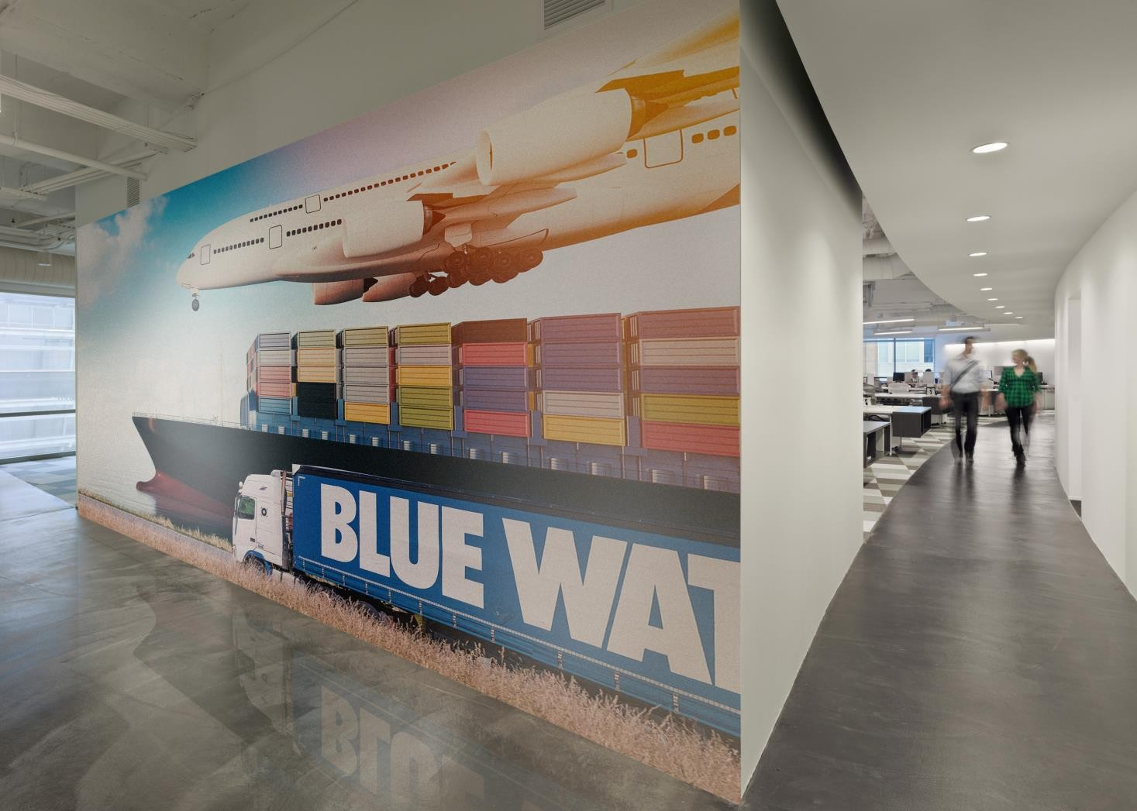
Questions?
Thank you!
Contacts:
David Thorpe
Global Head- Chemicals
dhpi@bws.dk

